Slide 1
MapReduce
Daphne Lopez and Brijendra Singh

Slide 2
MapReduce Framework
Simple data-parallel programming model
For large-scale data processing
Exploits large set of commodity computers
Executes process in distributed manner
Offers high availability
Pioneered by Google
Processes 20 petabytes of data per day
Popularized by open-source Hadoop project
Used at Yahoo!, Facebook, Amazon, …

Slide 3
What is MapReduce used for?
At Google:
Index construction for Google Search
Article clustering for Google News
Statistical machine translation
At Yahoo!:
“Web map” powering Yahoo! Search
Spam detection for Yahoo! Mail
At Facebook:
Data mining
Ad optimization
Spam detection

Slide 4
Large Scale Data Processing
Want to use hundreds or thousands of CPUs ... but this needs to be easy!
MapReduce provides
User-defined functions
Automatic parallelization and distribution
Fault-tolerance
I/O scheduling
Status and monitoring

Slide 5
Research Applications
In research:
Astronomical image analysis
Bioinformatics
Analyzing Wikipedia conflicts
Natural language processing
Particle physics
Ocean climate simulation

Slide 6
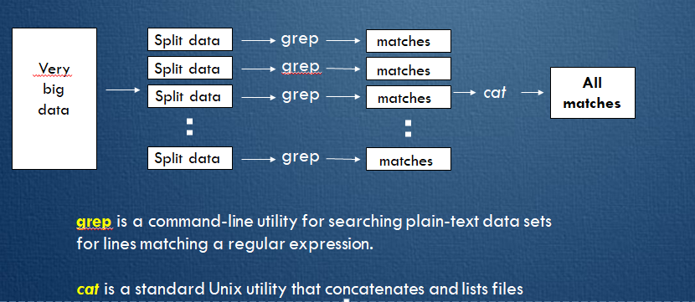
Distributed ‘grep’

Slide 7
Distributed word count
Split data
count
count
Split data
count
count
Very
big
data
merged
count
Split data
count
count
merge
Split data
count
count

Slide 8
MapReduce framework

Slide 9
MapReduce framework
Input data flows through the Map and Reduce functions to generate the output result under the control flow using MapReduce software library. Special user interfaces are used to access the Map and Reduce resources.

Slide 10
MapReduce Terminologies
Job – A “full program” - an execution of a Mapper and Reducer across a data set
Task – An execution of a Mapper or a Reducer on a slice of data
a.k.a. Task-In-Progress (TIP)
Task Attempt – A particular instance of an attempt to execute a task on a machine

Slide 11
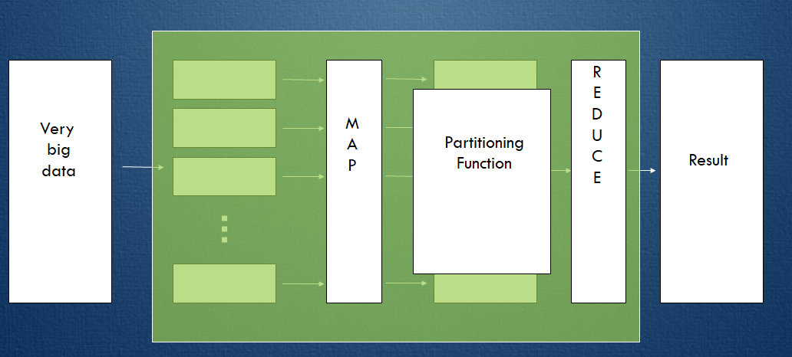
Map and Reduce

Slide 12
Map and Reduce
Map:
Accepts input key/value pair
Emits intermediate key/value pair
Reduce :
Accepts intermediate key/value* pair
Emits output key/value pair

Slide 13
Map and Reduce
MapReduce is a method for distributing a task across multiple nodes
Each node processes data stored on that node
Consists of two phases:
Map
Reduce
Map: (K1, V1) -> (K2, V2)
Reduce: (K2, list(V2)) -> list(K3, V3)

Slide 14
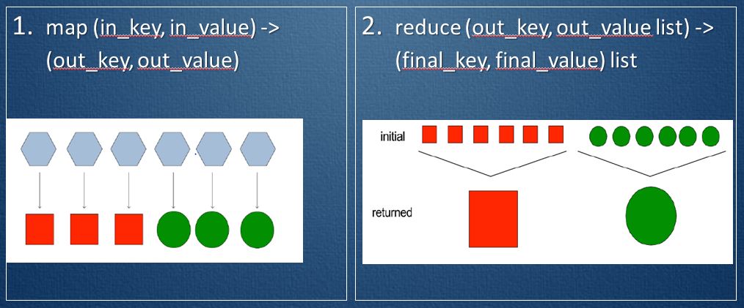
Map and Reduce Process

Slide 15
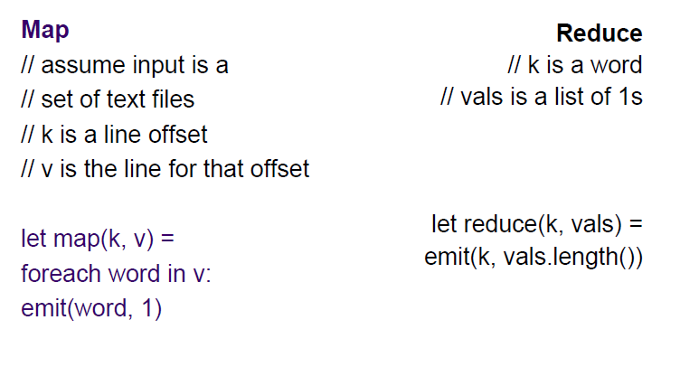
MapReduce word count example
Notes:
Key is address of line
value is line

Slide 16
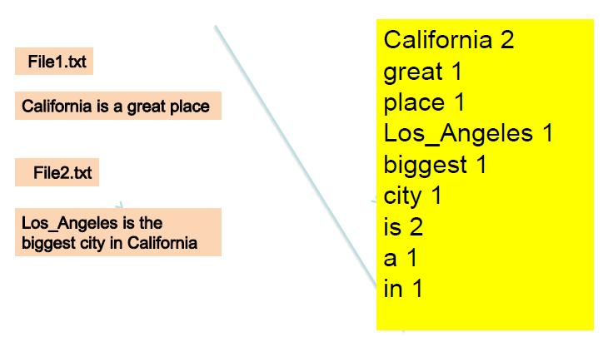
Input/Output for Map Reduce Job

Slide 17
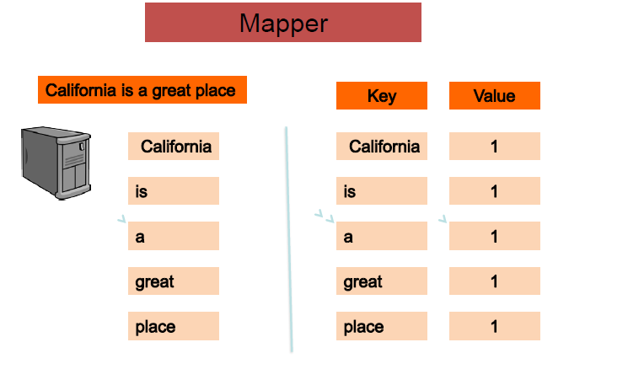
Word Count Mapper 1

Slide 18
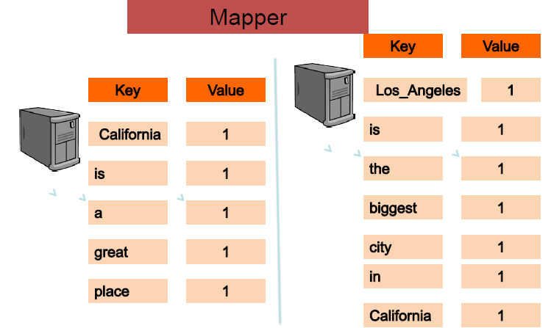
Word Count Mapper 2

Slide 19
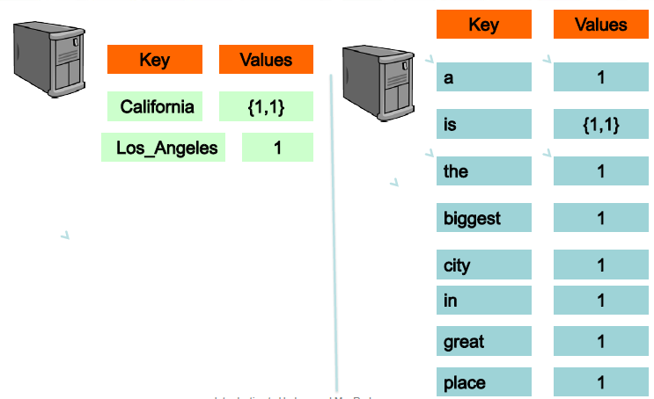
Word Count Input Reducer

Slide 20
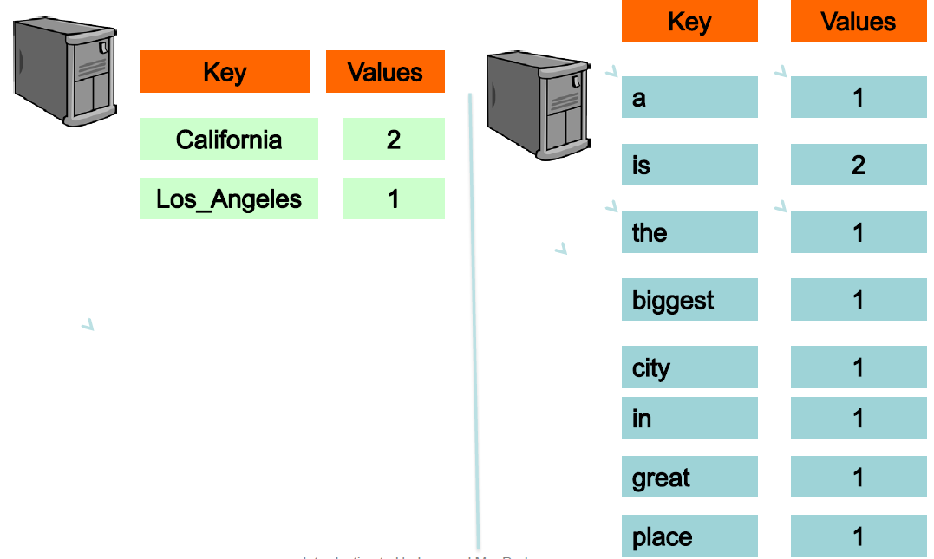
Word Count Reducer Output

Slide 21
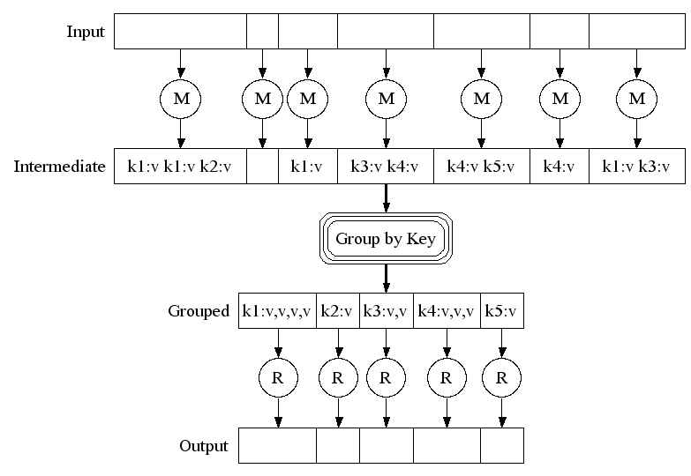
MapReduce Framework(Google)

Slide 22
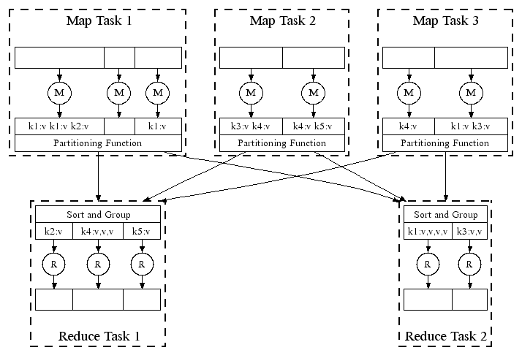
Automatic Parallel Execution Handles failures automatically, e.g., restarts tasks if a node fails; runs multiples copies of the same task to avoid a slow task slowing down the whole job

Slide 23
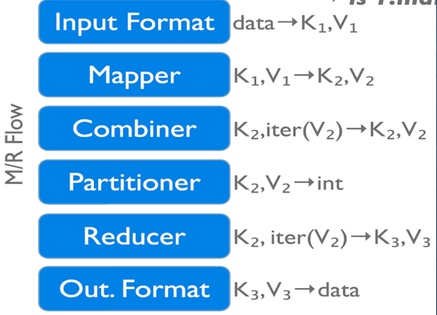
Data flow in a MapReduce Program

Slide 24
Data Flow explained
InputFormat describes the input-specification for a Map/Reduce job.
The Map/Reduce framework relies on the InputFormat of the job to:
1. Validate the input-specification of the job.
2. Split-up the input file(s) into logical InputSplit instances, each of which is then assigned to an individual Mapper. Mapper maps input key/value pairs to a set of intermediate key/value pairs.
Reducer reduces a set of intermediate values which share a key to a smaller set of values.

Slide 25
Data Flow explained
Shuffle: Input to the Reducer is the sorted output of the mappers. In this phase the framework fetches the relevant partition of the output of all the mappers.
Sort: The framework groups Reducer inputs by keys (since different mappers may have output the same key) in this stage.
The shuffle and sort phases occur simultaneously; while map-outputs are being fetched they are merged.

Slide 26
Data Flow explained
Partitioner: partitions the key space. Partitioner controls the partitioning of the keys of the intermediate map-outputs.
Reporter: Reporter is a facility for Map/Reduce applications to report progress, set application-level status messages and update Counters.
OutputCollector: It is a generalization of the facility provided by the Map/Reduce framework to collect data output by the Mapper or the Reducer (either the intermediate outputs or the output of the job).
Hadoop Map/Reduce comes bundled with a library of generally useful for mappers, reducers, and partitioners.

Slide 27
Getting Data to the Mapper

Slide 28
Creating Mapper
You provide the instance of Mapper
Should extend MapReduceBase
One instance of your Mapper is initialized by the MapTaskRunner for a TaskInProgress
Exists in separate process from all other instances of Mapper – no data sharing

Slide 29
Mapper
void map(K1 key,
V1 value,
OutputCollector<K2, V2> output,
Reporter reporter)
K types implement WritableComparable
V types implement Writable
Notes:
WritableComparable and Writable are the interfaces which describes the behavior of the class.

Slide 30
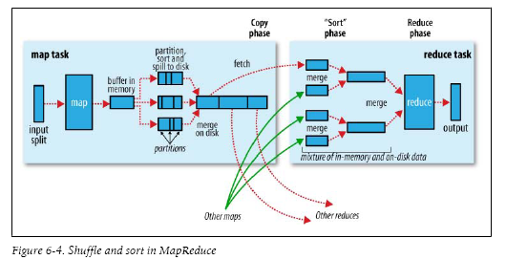
Shuffle and Sort

Slide 31
Data Reading
Data sets are specified by InputFormats
Defines input data (e.g., a directory)
Identifies partitions of the data that form an InputSplit
Factory for RecordReader objects to extract (k, v) records from the input source
Notes:
Factory method lets a class defer instantiation to subclass.

Slide 32
FileInput Formats
TextInputFormat – Treats each ‘\n’-terminated line of a file as a value
KeyValueTextInputFormat – Maps ‘\n’- terminated text lines of “k SEP v”
SequenceFileInputFormat – Binary file of (k, v) pairs with some add’l metadata
SequenceFileAsTextInputFormat – Same, but maps (k.toString(), v.toString())

Slide 33
Filtering File Input
FileInputFormat will read all files out of a specified directory and send them to the mapper
Delegates filtering this file list to a method subclasses may override
e.g., Create your own “xyzFileInputFormat” to read *.xyz from directory li

Slide 34
Record Readers
Each InputFormat provides its own RecordReader implementation
Provides capability multiplexing
LineRecordReader – Reads a line from a text file
KeyValueRecordReader – Used by KeyValueTextInputFormat

Slide 35
Input Split size
FileInputFormat will divide large files into chunks
Exact size controlled by mapred.min.split.size
RecordReaders receive file, offset, and length of chunk
Custom InputFormat implementations may override split size

Slide 36
Data to Reducers
Map function receives OutputCollector object
OutputCollector.collect() takes (k, v) elements
Any (WritableComparable, Writable) can be used
By default, mapper output type assumed to be same as reducer output type

Slide 37
Writable Comparator
Compares Writable Comparable data
Will call WritableComparable.compare()
Can provide fast path for serialized data

Slide 38
Sending data to the client
Reporter object sent to Mapper allows simple asynchronous feedback
incrCounter(Enum key, long amount)
setStatus(String msg)
Allows self-identification of input
InputSplit getInputSplit()

Slide 39
Partition and Shuffle

Slide 40
Partitioner
int getPartition(key, val, numPartitions)
Outputs the partition number for a given key
One partition == values sent to one Reduce task
HashPartitioner used by default
Uses key.hashCode() to return partition num
JobConf sets Partitioner implementation
Notes:
JobConf is a object which sets Partitioner function implementation

Slide 41
Reduction
reduce( K2 key,
Iterator<V2> values,
OutputCollector<K3, V3> output,
Reporter reporter )
Keys & values sent to one partition all go to the same reduce task

Slide 42
Writing the output

Slide 43
Writing the output
Analogous to InputFormat
TextOutputFormat – Writes “key val\n” strings to output file
SequenceFileOutputFormat – Uses a binary format to pack (k, v) pairs
NullOutputFormat – Discards output
Only useful if defining own output methods within reduce()

Slide 44
Word Count
map()
Receives a chunk of text
Outputs a set of word/count pairs
reduce()
Receives a key and all its associated values
Outputs the key and the sum of the values

Slide 45
Thank You

